Slide 1

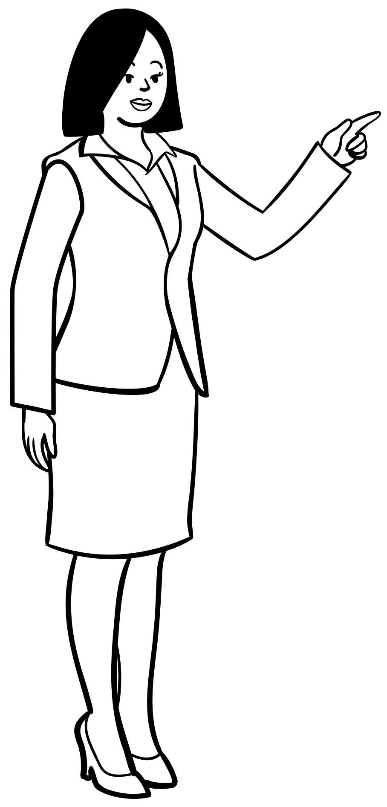
DH 401- Mentorship Presentation.
Client recruitment and Retention; and Transfers and Termination.
Submitted to: Mrs. Catherine Grater-Nakamura, RDH
Presented by:
BARMI, Sonia
CHAUHAN, Navneet
DOAL, Amrita
KAUR, Anmol deep
KAUR, Gurleen
KHAN, Faaris

Slide 2

Content:
Client Recruitment
Advertising Guidelines
Client Retention
Client Transfer
Client Termination
Brochure

Slide 3
Client
Recruitment
FIRST STEP: Review the Competency requirements.
SECOND STEP: MAKE A LIST OF WHAT TYPE OF CLIENTS YOU NEED, which are :-
ADULT MINIMAL = (DD1,DD2A)
SENIOR = (AGE 55 AND ABOVE) AND MINIMUM OF 12 TEETH PRESENT
CHILD = (AGE 5-12 WITH MIXED DENTITION)
PERIO = (DD2C, DD3, DD4) AND MINIMUM OF 20 TEETH PRESENT
ADOLESCENT = (AGE 13-17) (ONLY REQUIRED IN LEVEL 3)

Slide 4


WHERE TO FIND CLIENTS ?
FAMILIES AND FRIENDS ARE BEST BACK UP.
SOCIAL MEDIA IS BEST PLACE TO FIND CLIENTS. HOWEVER, REMEMBER SOME FACTS WHILE POSTING AN ADVERTISEMENT.
HOLY PLACES LIKE HINDU TEMPLE, CHURCH, MOSQUE AND SIKH GURDWARA ARE GOOD OPTIONS. YOU CAN FIND CLIENTS OF ALL AGES.
CONTACT LOCAL ORGANIZATION SUCH AS COMMUNITY CENTRES, REFUGEE CENTRE, FOOD BANKS. TRY TO LOOK FOR AREAS NEAR THE SCHOOL.
ASK UBER DRIVERS.
FRONT DESK.

Slide 5
IMPORTANT
TRANSFER OF CLIENTS AMONG CLASSMATES IS ALSO AN OPTION.
FOR EXAMPLE: YOUR LEVEL 2 adult CASE CAN BECOME YOUR FRIEND'S LEVEL 3 adult minimal case. THIS IS ALSO APPLICABLE FOR L2 CHILD ATTEMPT.
NOTE: CASE CLIENTS HAVE TO BE NEW TO YOU, BUT NOT NEW TO CADH.
Your L2 senior case can be your L3 senior attempt.

Slide 6


Advertisement Guidelines:

Slide 7





Restriction on using the CADH logo.
To maintain professional integrity.
Avoid using words/terms “free”, “no-cost”, or “reimbursement/reimburse”
Terms like these are misleading and can set false expectations.
Providing Personal information
Listing ONLY the services that are provided at CADH.
Clearly communicate the services provided and pertinent information and the charges associated.
(CADH Student Handbook 2023, p. 11)

Slide 8




Social media post:
Hello,
I’m a dental hygiene student in The Canadian Academy of Dental Health and Community Sciences working under the supervision of a registered dental hygienist and Dentist. Looking for volunteers who want to get their teeth cleaned. As it is a learning institution MULTIPLE appointments are required (4 hours each).
Services provided:
- Dental Cleaning
- Oral cancer screening
- Dental radiographs (if needed)
- Dietary Counselling
- Dental exam
- Periodontal exam
- Plaque & calculus/tartar assessment
- Oral Hygiene Education
- Coronal polish
- Fluoride
~~~~And more !!!
Please message me to book in.

Slide 9
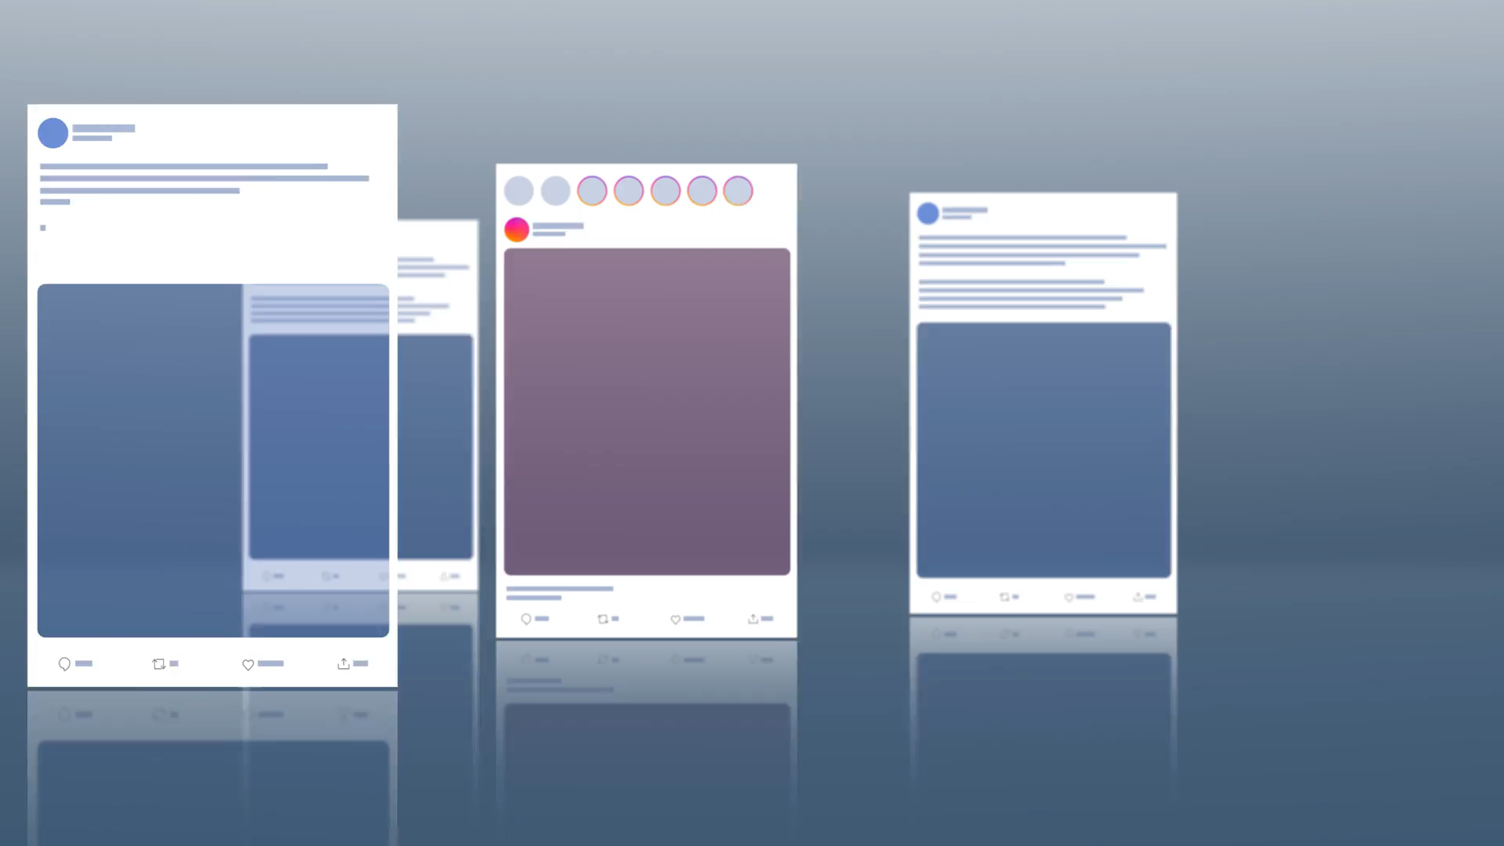
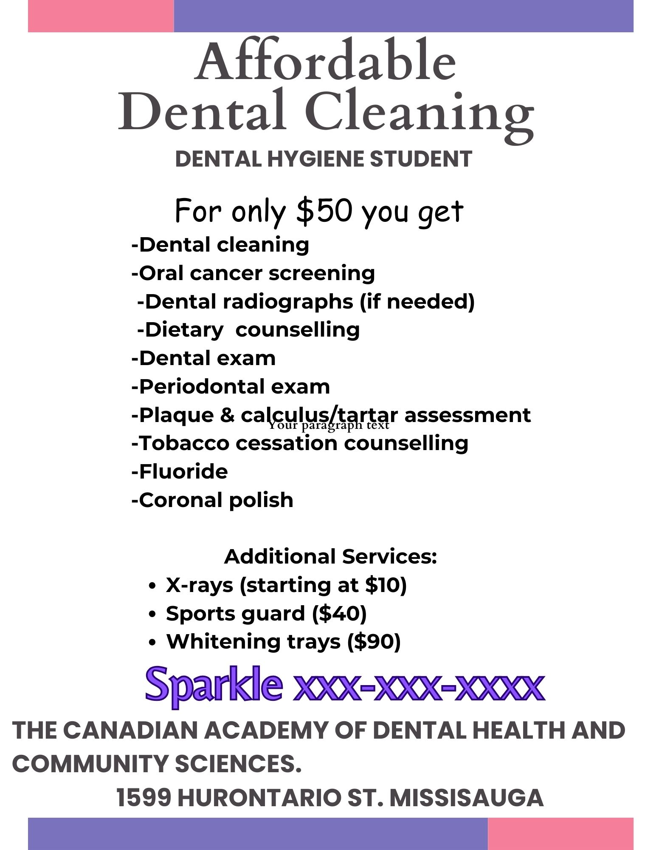
SAMPLE

Slide 10
Retention
Developing good interpersonal skill: By showing empathy and care towards your parent. Understanding their concerns and fears. Active listening.
Providing good patient care: which involves creating personalized treatment plans tailored to each Indvidual client's needs.
Communication: Use simple language to explain complex dental terms. Ensure the patient is aware of their options and why certain procedures are necessary.
Retaining clients is a crucial aspect of clinic. Client retention refers to the ability of maintaining consistency and satisfaction with your clients.

Slide 11

Environment: Create a welcoming and friendly environment. This will help reduce client anxiety. Pain management is available to clients who need to help minimize discomfort.
Professionalism: Respect patient confidentiality and privacy. Make them feel secure about sharing their medical history and concerns. Be punctual of your client's time.
After care is completed: Try to follow up with your client for feedback and check in on how they're feeling after their dental procedures.

Slide 12

Booking and confirming appointments
The CADH manual provides guidance on how to appropriately approach your clients and confirm appointments. "Hello, my name is ____. I am calling from CADH and I am assigned to provide your dental hygiene care until my graduation. I am eager to meet you in person. Your upcoming appointment is scheduled for (due date). I have availability on (date 1) and (date 2). Please let me know which date suits you best, and I will be happy to schedule your appointment."
If a client does not answer be sure to leave a voicemail or a text. That way they know who is calling and their purpose.
Try to book clients at least two weeks in advance. Be sure to provide a one week reminder, a 2 day reminder and a 1 day reminder.

Slide 13
Cancellations
Cancellations result in lost clinical time, so it is important to inform clients about CADH cancellation policy and the significance of timely dental hygiene care.
Effective communication, proactive approaches and adaptability are crucial in handling appointments.
Reach out to a client directly and stress the importance of their appointments.
Try to fill empty slots. Contact clients from the short notice list, ask the receptionist for potential stand by or drop in clients, ask individuals who accompanying other clients if they would be interested in receiving care.

Slide 14
TRANSFER
Students can transfer clients in their client pool to peers to help them meet their own removal requirements, to complete competencies, to support other students, and fulfill requirements specified by the client.
Students can transfer clients to their peers or they can also transfer clients to the students from different levels.
Client transfer requests must be approved by the designated personnel.

Slide 15

STEP BY STEP
Transfer
· Discuss the transfer with another student and obtain agreement.
· Discuss the transfer with the client and obtain consent that could be in person or over the phone.
· Update the Communication Record. In case the assigned client is new to CADH and there is no chart, a Communication Record form still needs to be completed and submitted to the Front Desk Administrators to be kept until a chart is made.
· Complete the template for client transfer.
· Email the clinical coordinator, the clinic lead for your level, and reception – and copy the student you are transferring the client to.
- Email Subject Line: Client Transfer Request
- Body of the email: Completed template. All required information should be included in the template – no need to include additional information in the email unless absolutely necessary.
· Student 2 must reply to all acknowledging agreement to accept the client into their client pool.
The transfer request is approved, an email response will be provided to all.

Slide 16

Important instructions regarding transfer
In case of trading clients between students, each student required to send transfer request separately for both the clients.
In certain situation and request, transfers may be rejected by the faculty and all parties will receive an email regarding the disapproval. Email provided is missing or incomplete information can lead to denied transfer of clients by clinical coordinator and if students are able to provide required information and correct their mistake than chances of transfer are fairly high.

Slide 17
TRANSFER FORMAT
Client name: (LAST NAME, First Name)
Transfer from:
Transfer to:
Reason for transfer:
Date of Last Hyg:
Client consent:
Comm. Record updated:

Slide 18

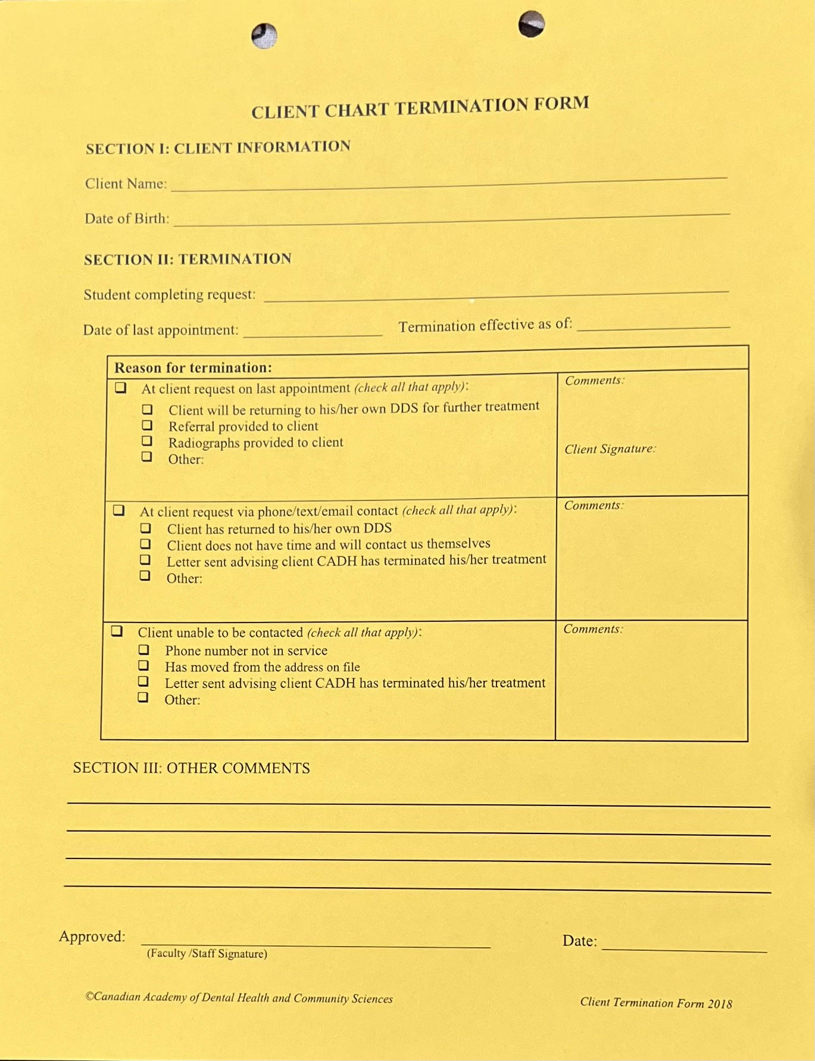
Client Termination

Slide 19
DURING CARE/ AFTER TREATMENT:
If the client does not want to come back due to personal reasons maybe moving to another province or in a different location.
Does not want to wait long and want to get the treatment done by his/her Dentist.
Ask for the reason.
State the reason on termination form.
Update in communication record form with the reason and confirmation.
Fill termination form and get signature from faculty on the termination form as well as on communication record.
Place the termination form in client's chart.

Slide 20

BROCHURE/Handout

Slide 21

LITERATURE CITED
Canadian Academy of Dental Health and Community Sciences. Student Handbook. Mississauga, ON;2023:11.

